Slide 1
Real-time web apps with ASP.NET Core SignalR
Carl in ‘t Veld, Sina Wahed
15 May 2019

Slide 2
Summary
Real-time scenarios everywhere
Event-driven architectures
What is SignalR
WebSockets in depth
Workshop tracks

Slide 3
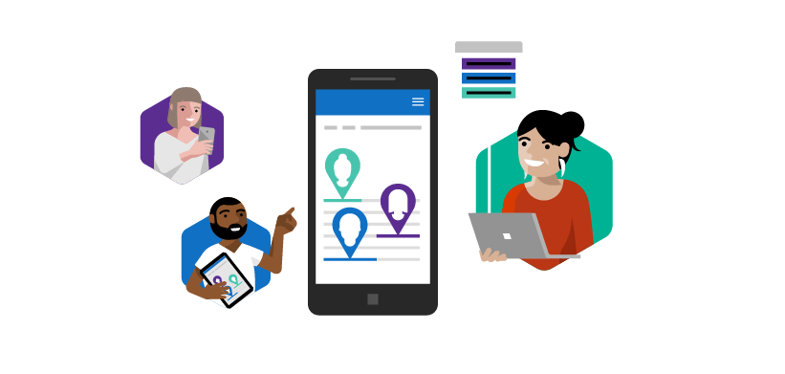



Real-time scenarios are everywhere Real time technologies are integral to many popular apps
Co-authoring
Real time location-based tracking
Notifications
Live dashboard

Slide 4
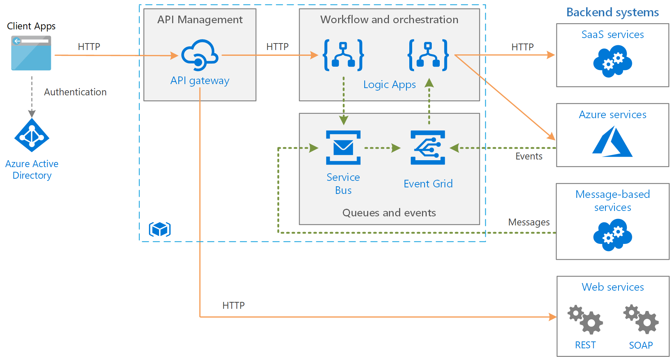

Azure SignalR Service
Azure Functions

Slide 5
SignalR is a series of open-source libraries that provide an abstraction that enables real-time HTTP.
Transports:
WebSockets
Server-Sent Events (one-way)
Long Polling (long http request/response)
Protocols:
Json
Message package ‘MessagePack’
Languages: TypeScript, .NET, Java

Slide 6

SignalR on old-school clients or servers
Got Data?
Got Data?
Got Data?
Got Data?
Here’s some data!
Got Data?
Client
Got Data?
Server
Got Data?
Got Data?

Slide 7
SignalR on new-school clients or servers
I do real time, do you?
Yeah, dude!
Let’s Party in Real-time!
Client
Server

Slide 8
Real-time messaging everywhere
Browsers
Desktop
Mobile
Games
HTTP
Timers
Orchestrations

Slide 9
Real-time messaging everywhere
Event Hubs
Event Grid
Cosmos DB
Queue
Service Bus
Microsoft Graph
Browsers
Desktop
Mobile
Games

Slide 10
Real-time messaging everywhere
Browsers
Desktop
Mobile
Games
Twitter
Salesforce
Slack
PagerDuty
SQL Server
…

Slide 11
SignalR then & now
ASP.NET SignalR
.NET Framework & JavaScript
Built using jQuery
Experimental Node.js and Java clients
PCL enabled
You had to be okay with dynamic in C#
Scale-out
Numerous attempts and solutions
Complex, non-trivial
Reconnections
Auto-reconnected by default
Also tried to replay messages by default, which resulted in a lot of complexity
ASP.NET Core SignalR
.NET Standard & Pure JavaScript
Runs anywhere – and faster, too!
Official Java client is in the works
No jQuery dependency
You don’t have to use dynamic in C#
Azure SignalR Service
Provides very simple, inexpensive scale-out
Not just for .NET!
Reconnections
No more automatic reconnection SignalR Core 3.0 will have some form of auto-reconnect

Slide 12
Side-by-side comparison
 | ASP.NET SignalR | ASP.NET Core SignalR
Server NuGet Package | Microsoft.AspNet.SignalR | Microsoft.AspNetCore.App (.NET Core) Microsoft.AspNetCore.SignalR (.NET Framework)
Client NuGet Packages | Microsoft.AspNet.SignalR.Client Microsoft.AspNet.SignalR.JS | Microsoft.AspNetCore.SignalR.Client
Client npm Package | Signalr | @aspnet/signalr
Java Client | https://github.com/SignalR/java-client (deprecated) | Maven package com.microsoft.signalr
Server App Type | ASP.NET (System.Web) or OWIN Self-Host | ASP.NET Core
Supported Server Platforms | .NET Framework 4.5 or later
See https://docs.microsoft.com/en-us/aspnet/core/signalr/version-differences

Slide 13
SignalR Future
Auto-reconnect
More clients: IOS, C++
User presence
TCP/IP real scenarios

Slide 14
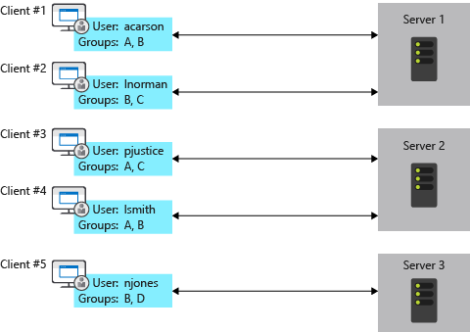
Load-balancing
The issue: no cross-node communication

Slide 15
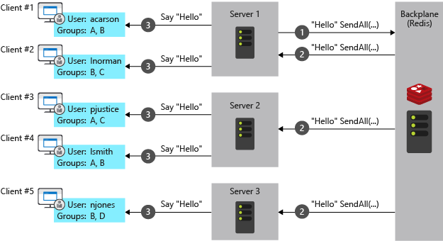
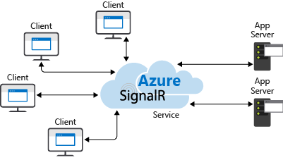
Load-balancing: The solution
On-premise: Redis Cache
Cloud: Azure SignalR Service

Slide 16
Azure SignalR Service
Fully managed real-time messaging platform
WebSockets, Server Sent Events, Long Polling
Broadcast to all, groups, or users

Slide 17


Azure Cosmos DB
Browser
Desktop App
Mobile App
Game
Changes
Collection
1
Azure Functions
Azure SignalR
Service
2
Change Feed
3
4
5
Cosmos DB trigger
SignalR output binding
WebSockets

Slide 18
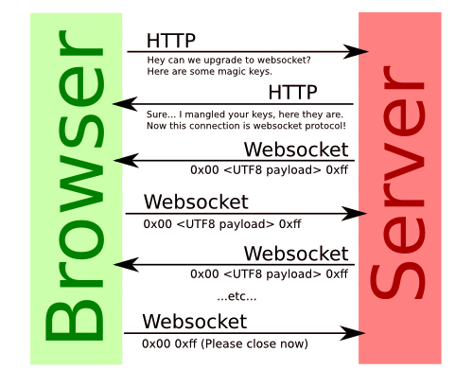
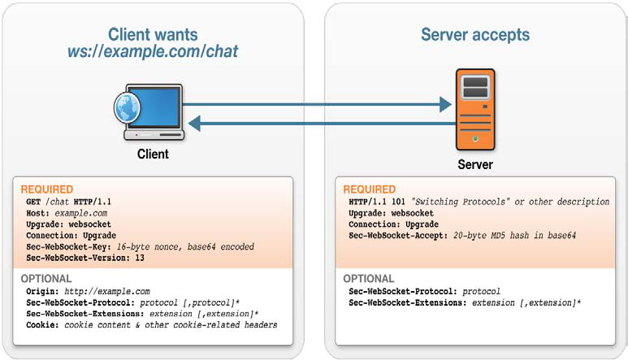
WebSockets in depth
Both, HTTP and WebSocket are located at layer 7 in the OSI model
WebSocket real-time data transfer from and to the server
Browser compatibility
Notes:
Open Systems Interconnection model
They are completely different. Websocket is designed to work over HTTP port 80 and 443. The websocket handshake uses the HTTP Upgrade header to change from HTTP to Websocket protocol
Before Websocket full-dupplex communication was achievable using Comet (coined in 2006, Http streaming and Http polling, Comet HTTP header overhead, it is also inefficient for small messages) channels.
Cost: (websocket: cost of communication is lower), (REST: compare to websockets, is relatively higher)
Performance (websocket: better with high loads), (REST: great for occional communication)

Slide 19
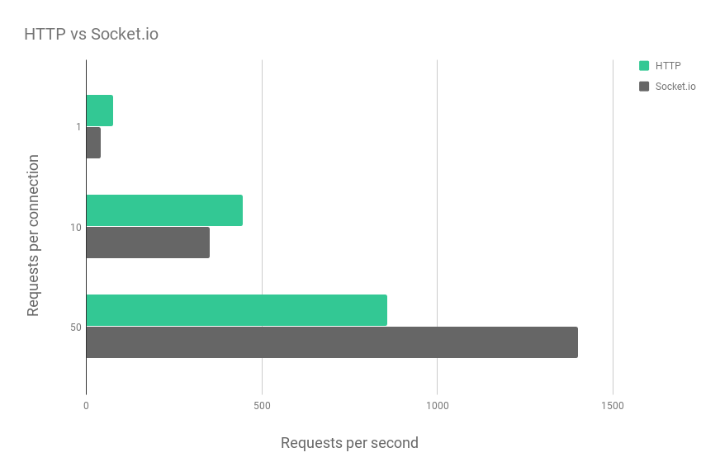
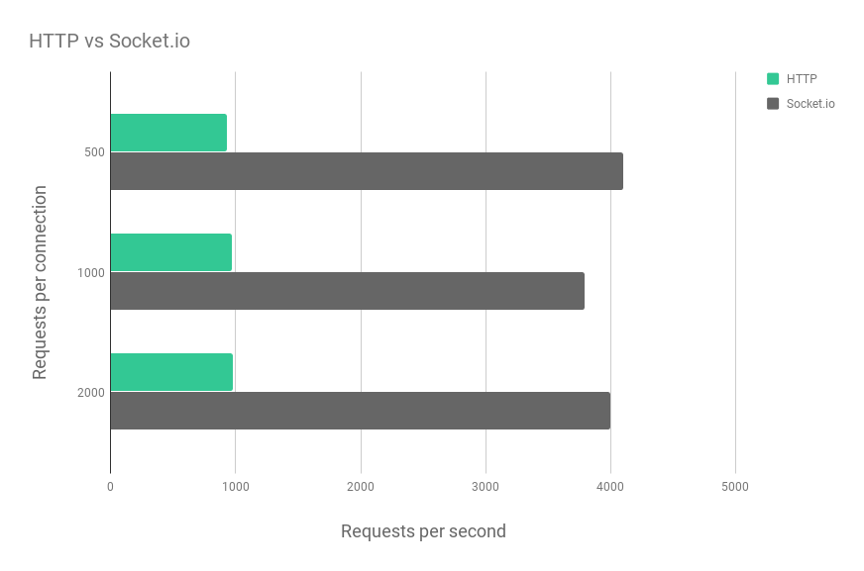
Full-duplex communication channel performance
Websocket | HTTP
1: 83 ms | 1 : (AVG) 107 ms
50: (AVG) 180 ms | 50 : (AVG) 5s
4000 requests per second | Overall 10 request per second (concurrent request max 6).
Notes:
Websocket: Bi-redictional in nature

Slide 20
Workshop Exercises (I)
In-depth WebSockets
https://github.com/swappdeveloper/WednesdayTrainingWebsocketExample
https://github.com/swappdeveloper/bitcoin-websocket
SignalR with ASP.NET Core
https://github.com/aspnet/SignalR-samples
SignalR with Angular and Azure Functions
https://github.com/cveld/DurableFunctionsExample

Slide 21
Workshop Exercises (II)
ASP.NET Core
Angular / Azure SignalR Service / Azure Functions
Samples:
Chat
MoveShape
StockTickR
WhiteBoard
https://github.com/aspnet/SignalR-samples
Concerns:
AuthN/AuthZ
MessagePack
Load balancing -> Redis Cache
Streaming
WebSockets without SignalR
https://docs.microsoft.com/en-us/aspnet/core/signalr
StreamR
https://github.com/SignalR/sample-StreamR
Initial setup
Workflow demo
Flights API
Fan-out Fractals
https://github.com/cveld/DurableFunctionsExample
SignalR / CosmosDB / AI:
https://anthonychu.ca/post/cosmosdb-real-time-azure-functions-signalr-service/
https://anthonychu.ca/post/realtime-captioning-translation-cognitive-services-signalr-azure-functions/

Slide 22
Read more
Microsoft Docs
https://docs.microsoft.com/en-us/aspnet/core/signalr
Samples
https://github.com/aspnet/SignalR-samples
GitHub Carl in ’t Veld
https://github.com/cveld/DurableFunctionsExample
GitHub Sina Wahed
https://github.com/swappdeveloper/WednesdayTrainingWebsocketExample
https://github.com/swappdeveloper/bitcoin-websocket

Slide 23
Title (Work for 1 or 2 lines of title)
Header
Header
Header
First level
Second level
Third level
Fourth level
Fifth level
First level
Second level
Third level
Fourth level
Fifth level
First level
Second level
Third level
Fourth level
Fifth level

Slide 24
Title (Work for 1 or 2 lines of title)
Header
Header
Header
First level
Second level
Third level
Fourth level
Fifth level
First level
Second level
Third level
Fourth level
Fifth level
First level
Second level
Third level
Fourth level
Fifth level
Header
Insert bullet point
Insert bullet point
Insert bullet point
Insert bullet point

Slide 25
Title (Work for 1 or 2 lines of title)
Header
Header
Header
Insert bullet point
Insert bullet point
Insert bullet point
Insert bullet point
Insert bullet point
Insert bullet point
Insert bullet point
Insert bullet point
Insert bullet point
Insert bullet point
Insert bullet point
Insert bullet point

Slide 26
Title (Work for 1 or 2 lines of title)
Insert name Insert Title/Role
Insert bullet point
Insert bullet point
Insert bullet point
Insert bullet point
Insert name Insert Title/Role
Insert bullet point
Insert bullet point
Insert bullet point
Insert bullet point
Insert name Insert Title/Role
Insert bullet point
Insert bullet point
Insert bullet point
Insert bullet point
Insert name Insert Title/Role
Insert bullet point
Insert bullet point
Insert bullet point
Insert bullet point

Slide 27
Title (Work for 1 or 2 lines of title)
1
Subtitle
 | TEXT | TEXT | TEXT | TEXT | TEXT | TEXT | TEXT
TEXT | Text sample | Text sample | Text sample | Text sample | Text sample | Text sample | Text sample
TEXT | Text sample | Text sample | Text sample | Text sample | Text sample | Text sample | Text sample
TEXT | Text sample | Text sample | Text sample | Text sample | Text sample | Text sample | Text sample
TEXT | Text sample | Text sample | Text sample | Text sample | Text sample | Text sample | Text sample

Slide 28
Title (Work for 1 or 2 lines of title)
Click to insert chart title
Click to insert chart title
Click to insert text
Click to insert text

Slide 29
Title (Work for 1 or 2 lines of title)
1
2
3
4
5
6
7
8
9
10
11
12
Text sample
Text sample
Text sample
Text sample
Text sample
Text sample
Text sample
Text sample

Slide 30
Title (Work for 1 or 2 lines of title)
Click to insert chart title
Click to insert chart title

Slide 31
Title (Work for 1 or 2 lines of title)
Click to insert title
Click to insert title
Click to insert title
Click to insert title
Click to insert title
Click to insert bullet point
Click to insert bullet point
Click to insert bullet point
Click to insert bullet point
Click to insert bullet point
Click to insert bullet point
Click to insert bullet point
Click to insert bullet point
Click to insert bullet point
Click to insert bullet point
Click to insert bullet point
Click to insert bullet point
Click to insert bullet point
Click to insert bullet point
Click to insert bullet point

Slide 32
Title (Work for 1 or 2 lines of title)
XX%
XX%
XX%
XX%
Click to insert text
Click to insert text
Click to insert text
Click to insert text
XX%
Click to insert text

Slide 33
Title (Work for 1 or 2 lines of title)
Insert Group Name
Click to insert bullet point
Click to insert bullet point
Click to insert bullet point
Insert Group Name
Click to insert bullet point
Click to insert bullet point
Click to insert bullet point
Insert Group Name
Click to insert bullet point
Click to insert bullet point
Click to insert bullet point
Group Name
Click to insert text
Click to insert text
Click to insert text
Click to insert text
Click to insert text

Slide 34
Title (Work for 1 or 2 lines of title)
60%
50%
35%
Click to insert text
Click to insert text
Click to insert text
Click to insert bullet point
Click to insert bullet point
Click to insert bullet point
Click to insert bullet point
Click to insert bullet point
Click to insert bullet point
Click to insert bullet point
Click to insert bullet point
Click to insert bullet point

Slide 35
Click to insert title
Click to insert title
Photo
Click to insert bullet point
Click to insert bullet point
Click to insert bullet point
Click to insert bullet point
Click to insert bullet point
Click to insert bullet point
Click to insert title
Name
Click to insert bullet point
Click to insert bullet point
Click to insert bullet point
Text
Education
Text

Slide 36
Section break

Slide 37
Section break

Slide 38
Section break

Slide 39
Colors
Primary
Secondary
Infographic only
Capgemini Blue
R 0
G 112
B 173
Vibrant Blue
R 18
G 171
B 219
Deep Purple
R 43
G 10
B 61
Tech Red
R 255
G 48
B 76
Zest Green
R 149
G 230
B 22
Capgemini Blue (-50%)
R 128
G 184
B 214
Vibrant Blue (-50%)
R 136
G 213
B 237
Bright Purple
R 109
G 100
B 204
Orange
R 255
G 99
B 39
Bright Green
R 200
G 255
B 22
Purple
R 126
G 57
B 186
Peach
R 255
G 126
B 131
Green
R 0
G 195
B 123
Dark Purple
R 71
G 1
B 167
Light Claret
R 203
G 41
B 128
Bright Aqua
R 1
G 209
B 208
Claret
R 134
G 8
B 100
Aqua
R 15
G 153
B 156
Dark Green
R 21
G 99
B 107

Slide 40
World map
Texte
Texte
Texte
Texte
Texte
Texte
Texte
Texte
Texte
Texte

Slide 41
Icons

Slide 42
Icons

Slide 43
Graphic elements

